Slide 1
Comparing Libraries for Generic Programming in Haskell
by Rodriguez et al
Instructor:
Mattox Beckman
Prepared by:
Himangshu Das
UIUC CS421: Programming Languages and Compilers

Slide 2
Motivation
Extensive uses for Generic programming.
Lot of available libraries in Haskell.
Haskell is powerful enough to define generic programming libraries.

Slide 3
Benchmarking Criteria
Types
Universe Size
Subuniverses

Slide 4
Benchmarking Criteria
Expressiveness
First-class generic functions
Abstraction over type constructors
Separate compilation
Ad-hoc definitions for datatypes
Ad-hoc definitions for constructors
Extensibility
Multiple arguments
Multiple type representation arguments
Constructor names
Consumers

Slide 5

Benchmarking Criteria
Expressiveness
First-class generic functions
Abstraction over type constructors
Separate compilation
Ad-hoc definitions for datatypes
Ad-hoc definitions for constructors
Extensibility
Multiple arguments
Multiple type representation arguments
Constructor names
Consumers

Slide 6

Benchmarking Criteria
Expressiveness
First-class generic functions
Abstraction over type constructors
Separate compilation
Ad-hoc definitions for datatypes
Ad-hoc definitions for constructors
Extensibility
Multiple arguments
Multiple type representation arguments
Constructor names
Consumers

Slide 7

Benchmarking Criteria
Expressiveness
First-class generic functions
Abstraction over type constructors
Separate compilation
Ad-hoc definitions for datatypes
Ad-hoc definitions for constructors
Extensibility
Multiple arguments
Multiple type representation arguments
Constructor names
Consumers

Slide 8
Benchmarking Criteria
Usability
Performance
Portability
Overhead of library use
Practical aspects
Ease of learning and use

Slide 9
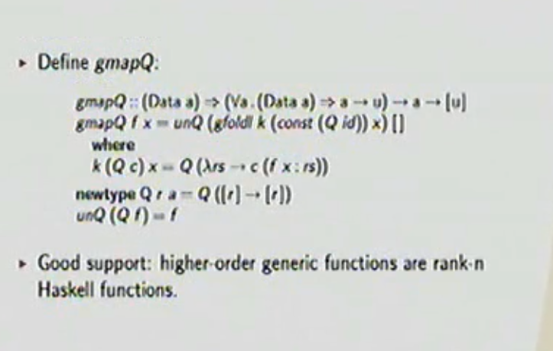
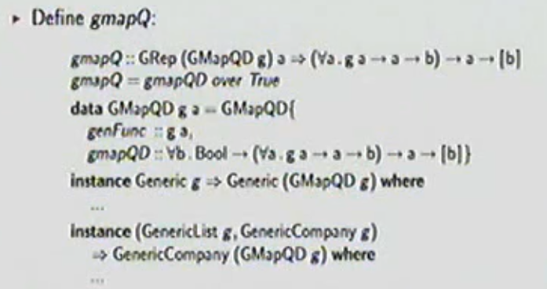
Test-1: First class generic functions

Slide 10
Test-1: First class generic functions
Result
﻿﻿Good support: LIGD, SYB, SYB3, Spine, Replib
﻿﻿Sufficient support: EMGM, Smash.
﻿﻿No support: PolyLib, Uniplate.

Slide 11
Test-2 Ad Hoc-definitions Result
﻿﻿﻿﻿Good support: SYB, SYB3, EMGM, RepLib, Smash, Uniplate.
﻿﻿Sufficient support: Polylib.
﻿﻿No support: LIGD, Spine.

Slide 12
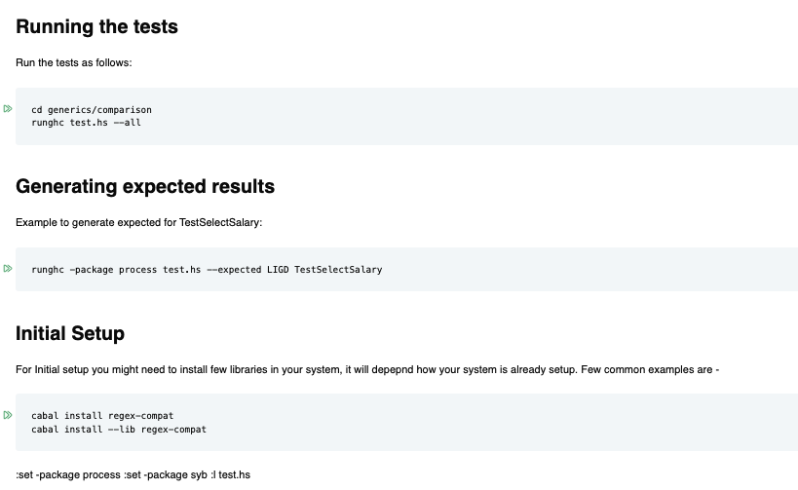
Running the tests

Slide 13
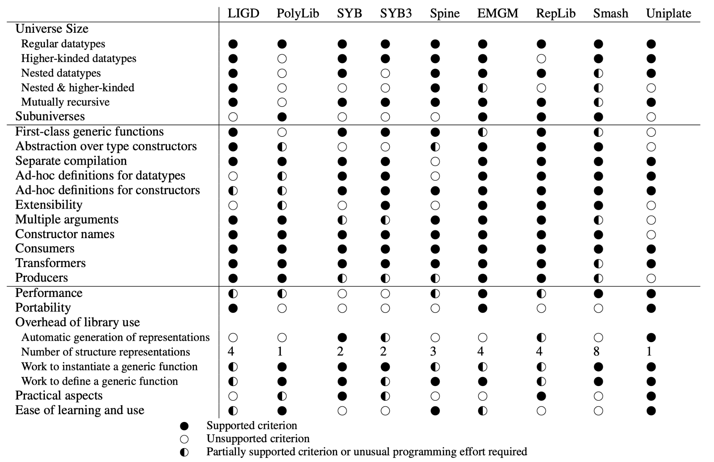
Evaluation

Slide 14
Thanks for watching!
Special thanks to the authors of the original paper Rodriguez, Jeuring, Jansson, Gerdes, Kiselyov, and Oliveira for their insightful paper, 'Comparing Libraries for Generic Programming in Haskell,' which formed the basis of my project. Their work has greatly contributed to my understanding and has been invaluable in guiding this study.
For questions and queries: https://dasshims.github.io
Repo: https://github.com/dasshims/UIUC-CS421-FinalProject-.git

Slide 15
Test-2: Ad Hoc-definitions

